Slide 1
Beauty saloon
Research presentation
Guidelines and requirements
Raimonds Arājs, Jurijs Bojārs, Māris Peskops

Slide 2
Strategy

Slide 3
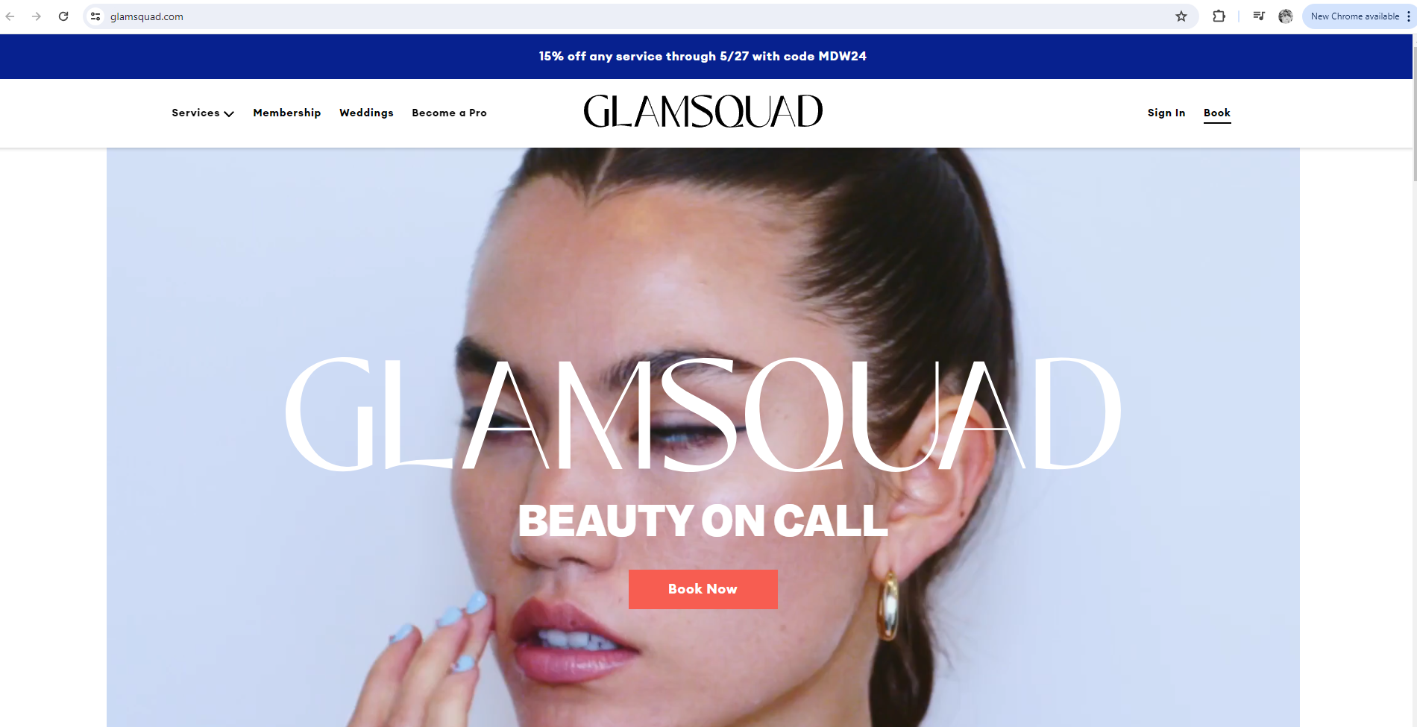
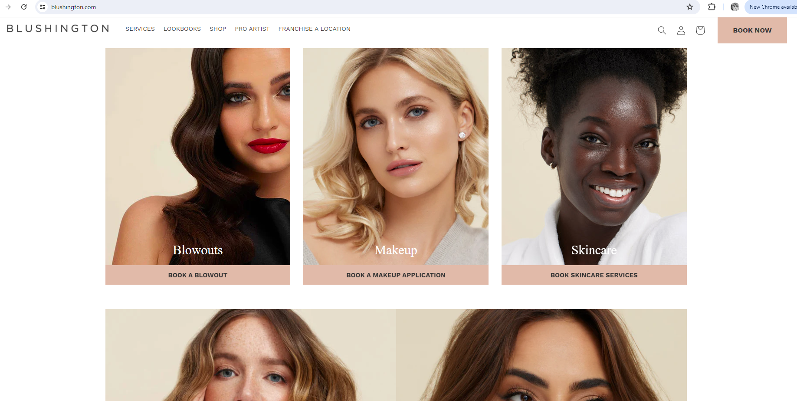
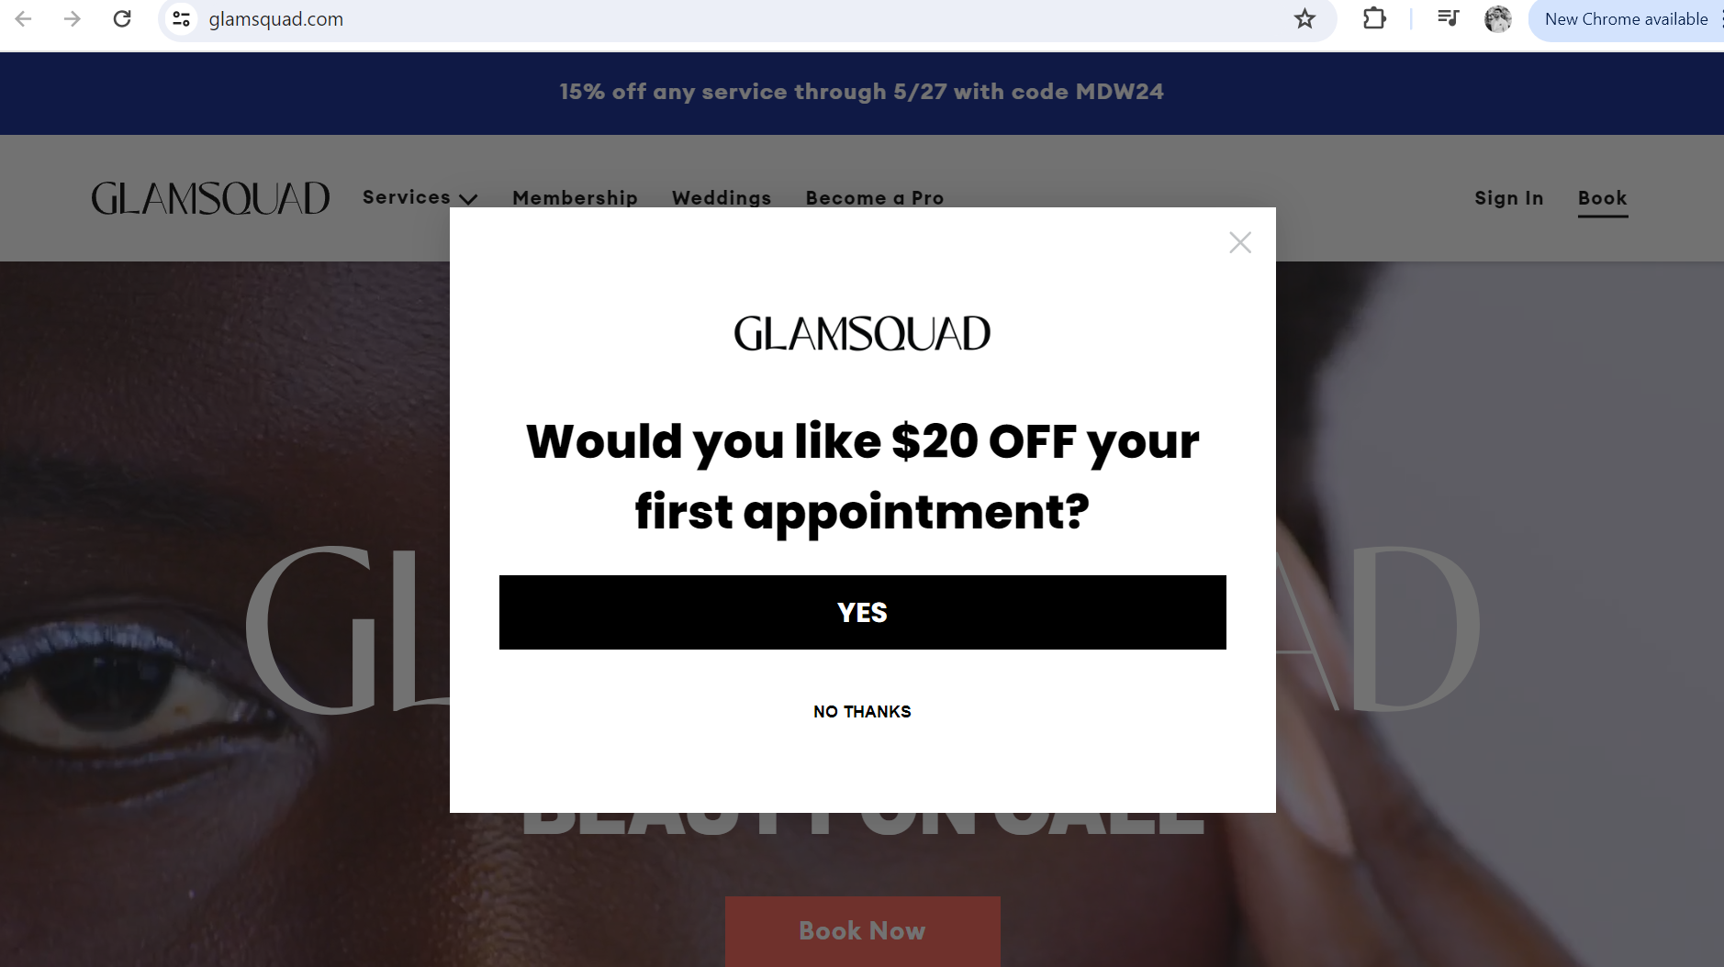
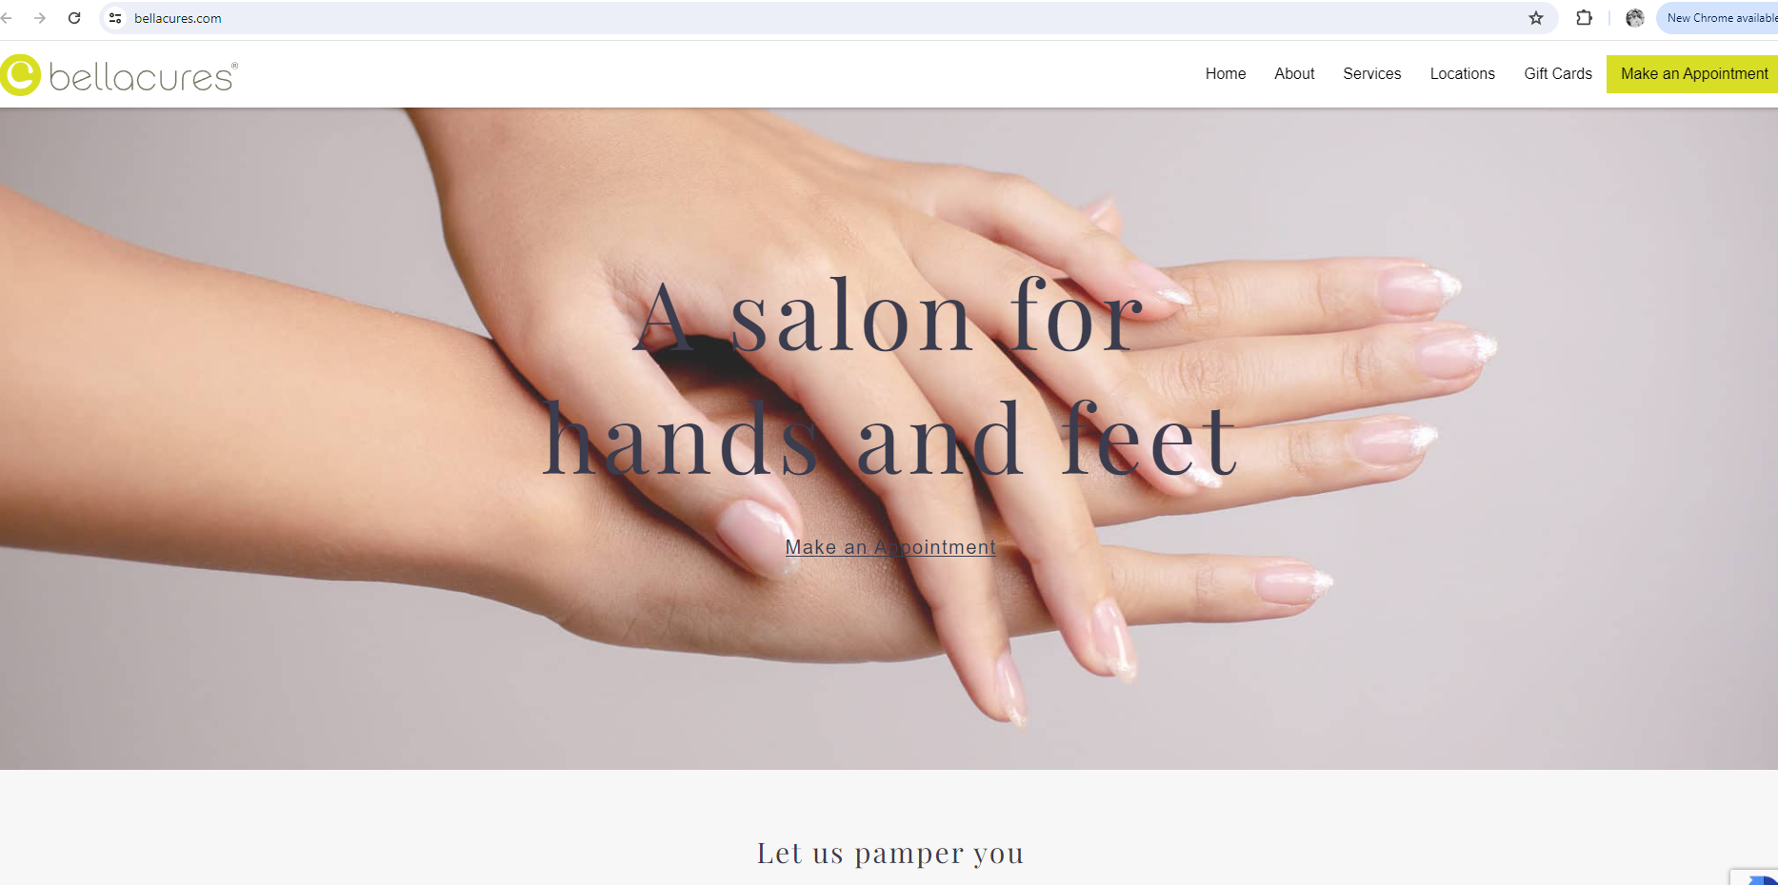
Website Development
Use simple navigation
Similar to competitors and best practices
Beaty saloon
Notes:
User-Friendly Design: Ensure the website is easy to navigate and visually appealing
Ensure the website is easy to navigate and visually appealing
Responsive Design: The site must be mobile-friendly.

Slide 4
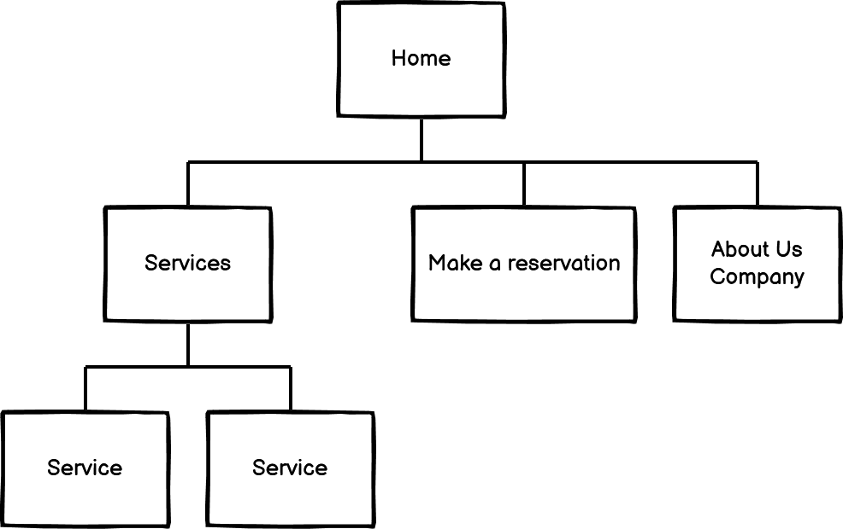
Sitemap structure
Notes:
User-Friendly Design: Ensure the website is easy to navigate and visually appealing
Ensure the website is easy to navigate and visually appealing

Slide 5
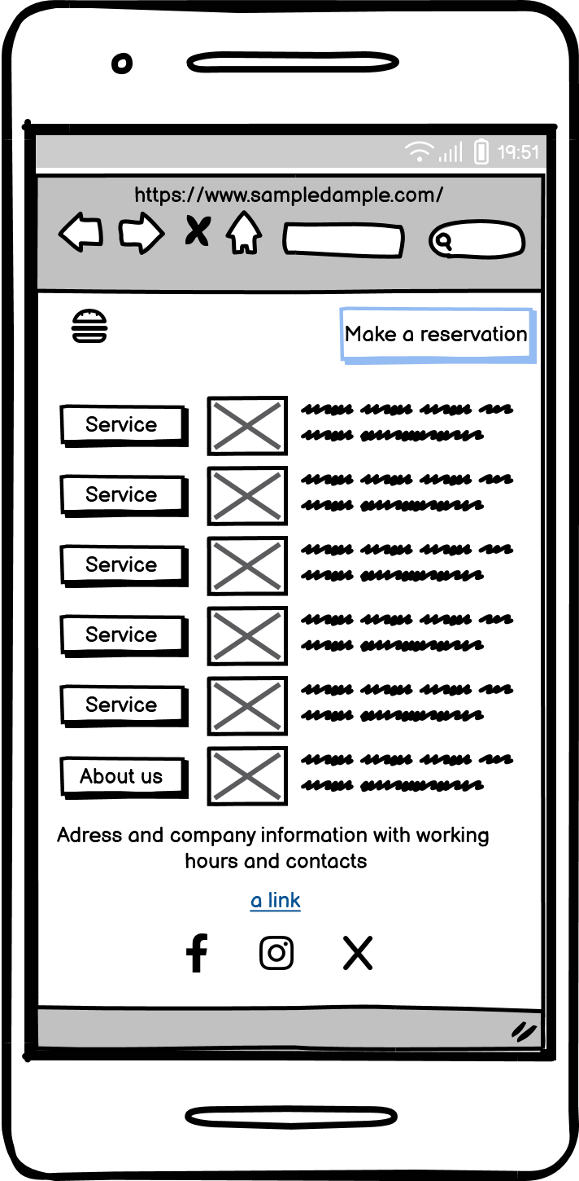
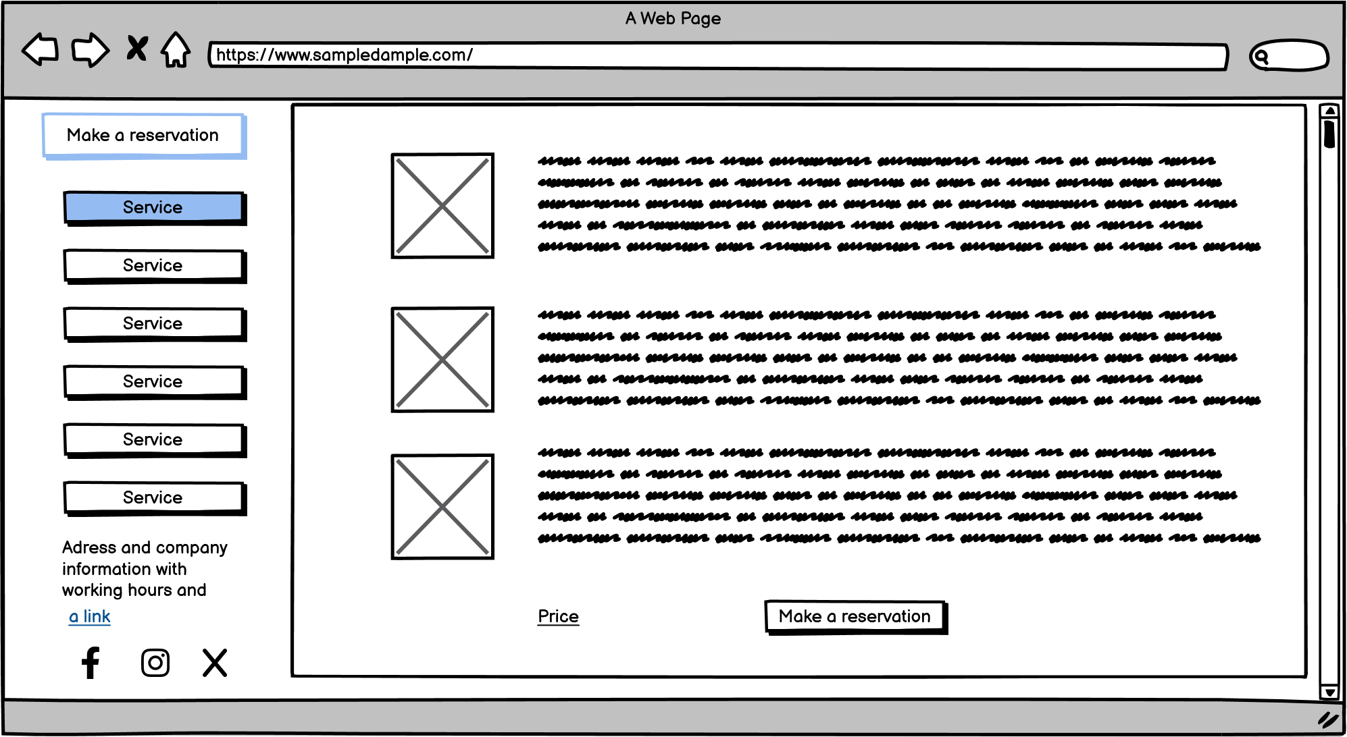
User-Friendly Design on all devices
Notes:
User-Friendly Design: Ensure the website is easy to navigate and visually appealing
Ensure the website is easy to navigate and visually appealing

Slide 6
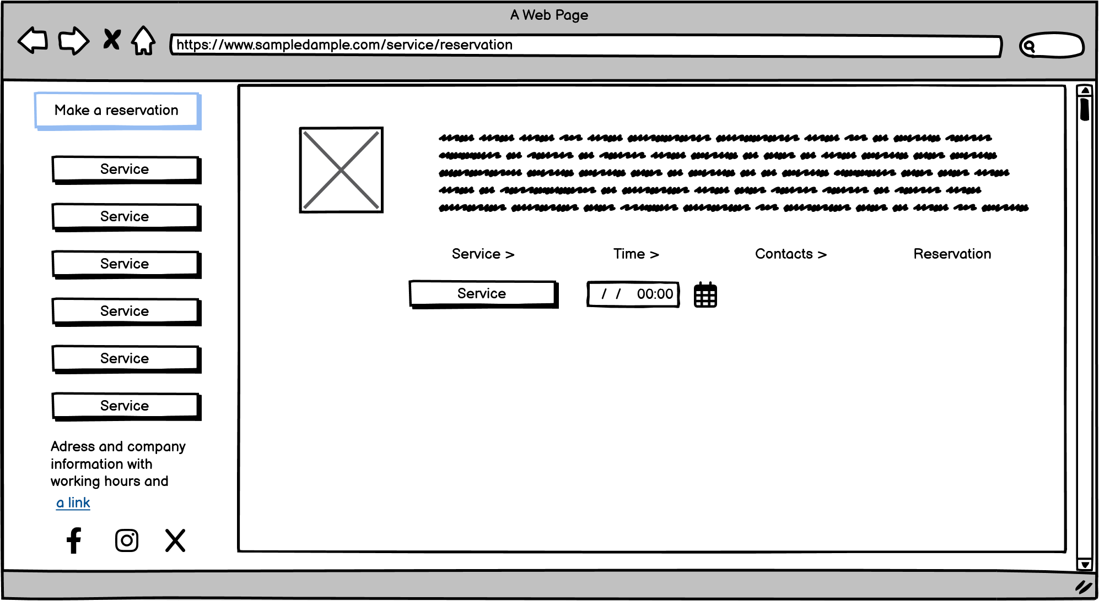
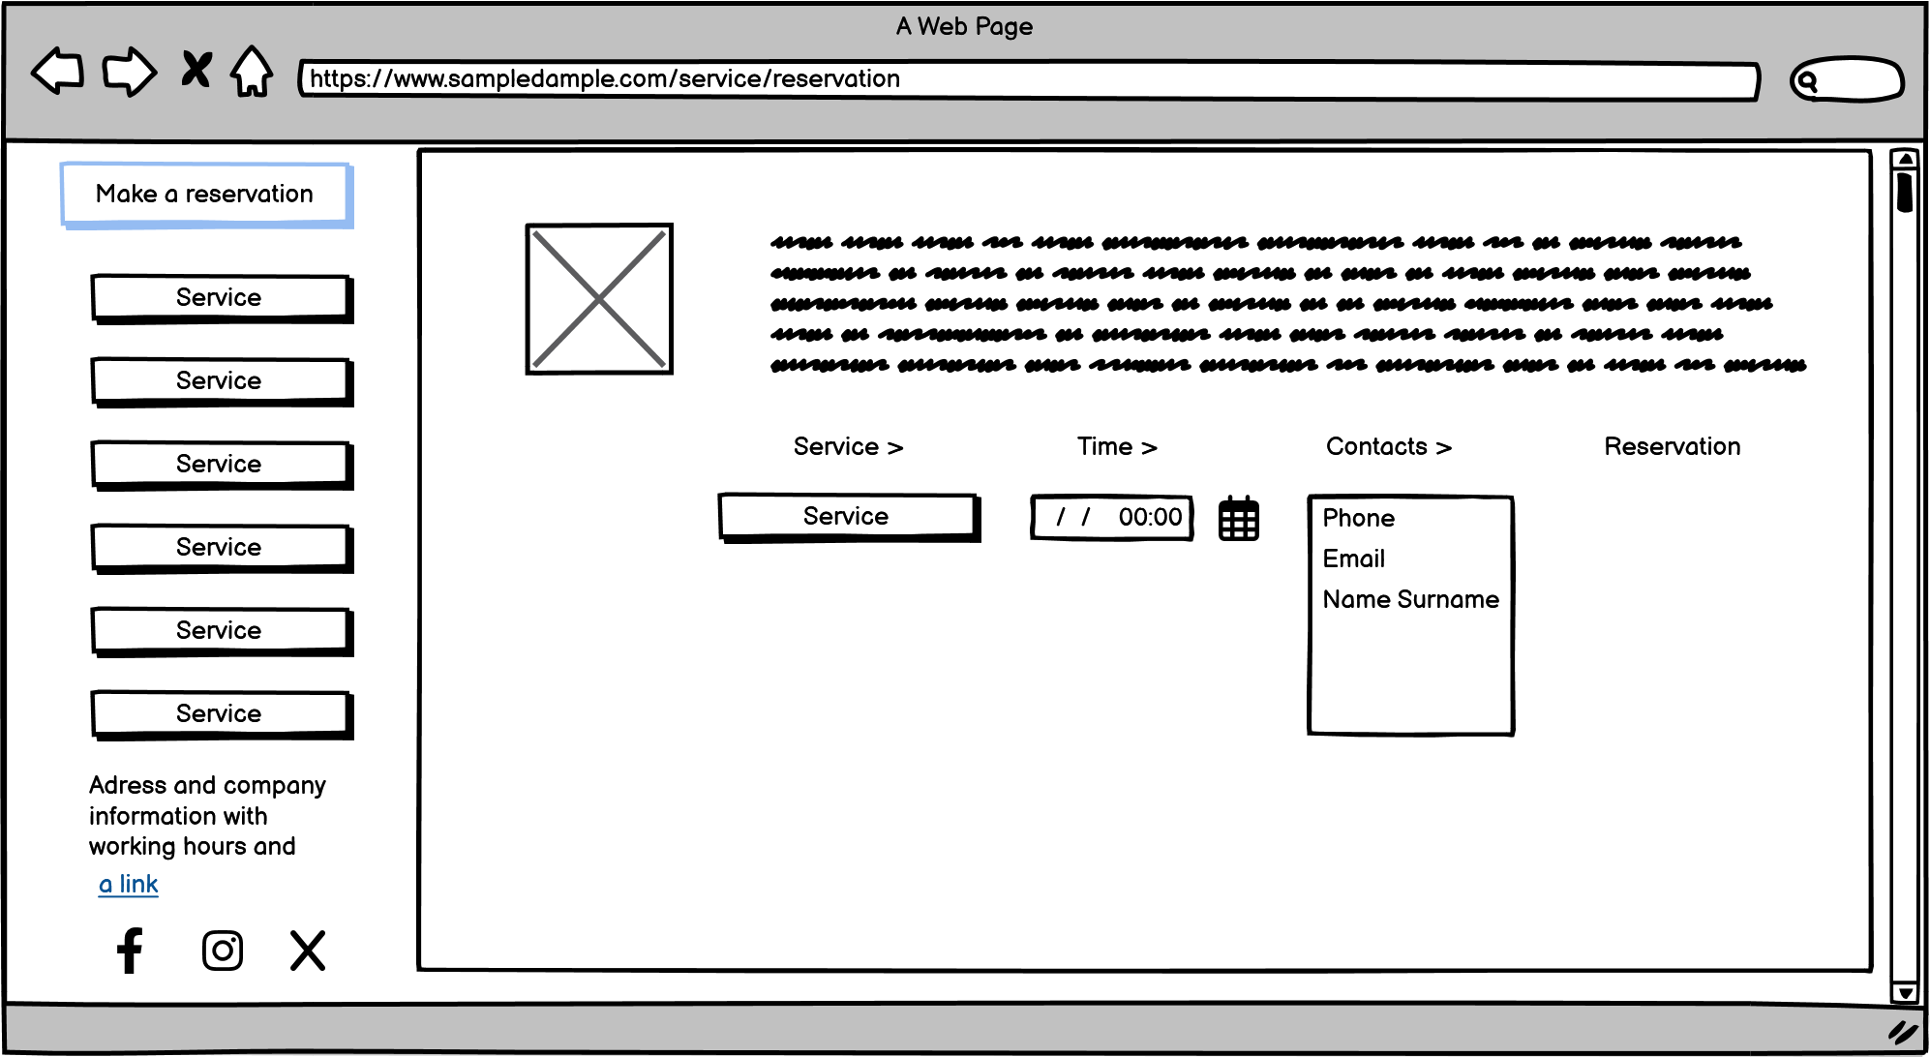
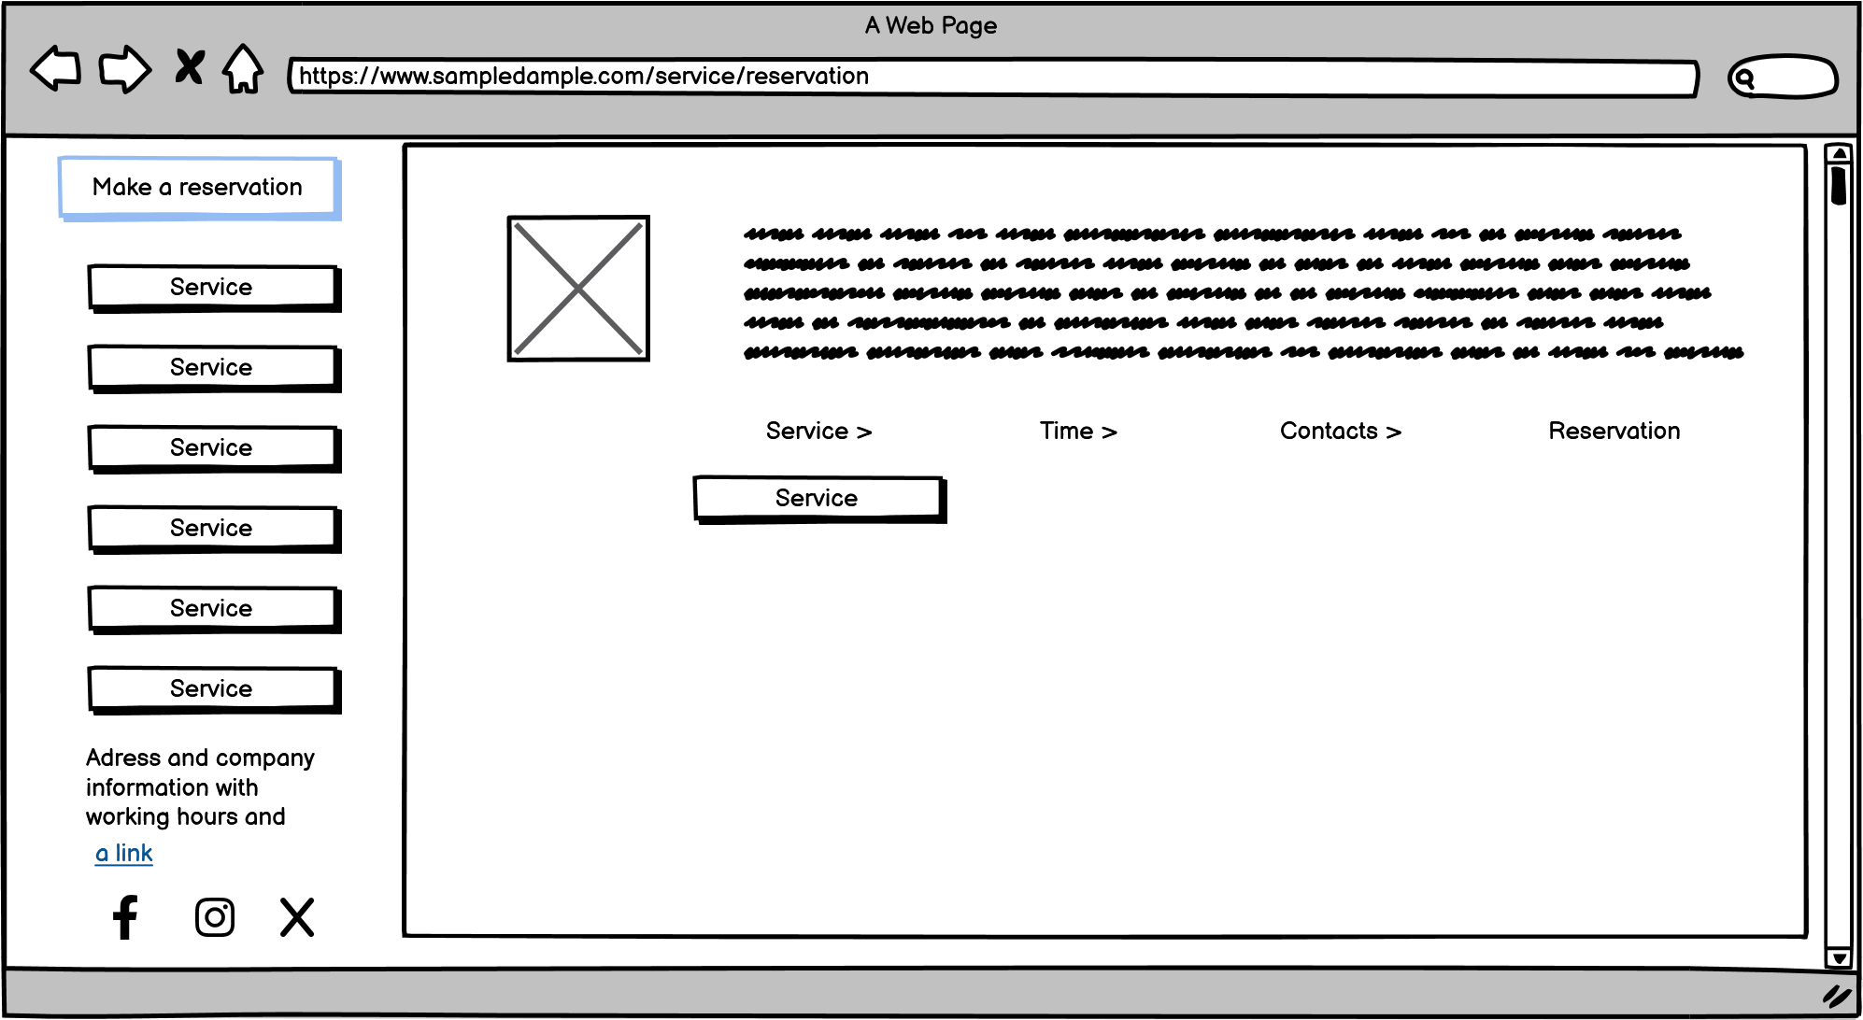
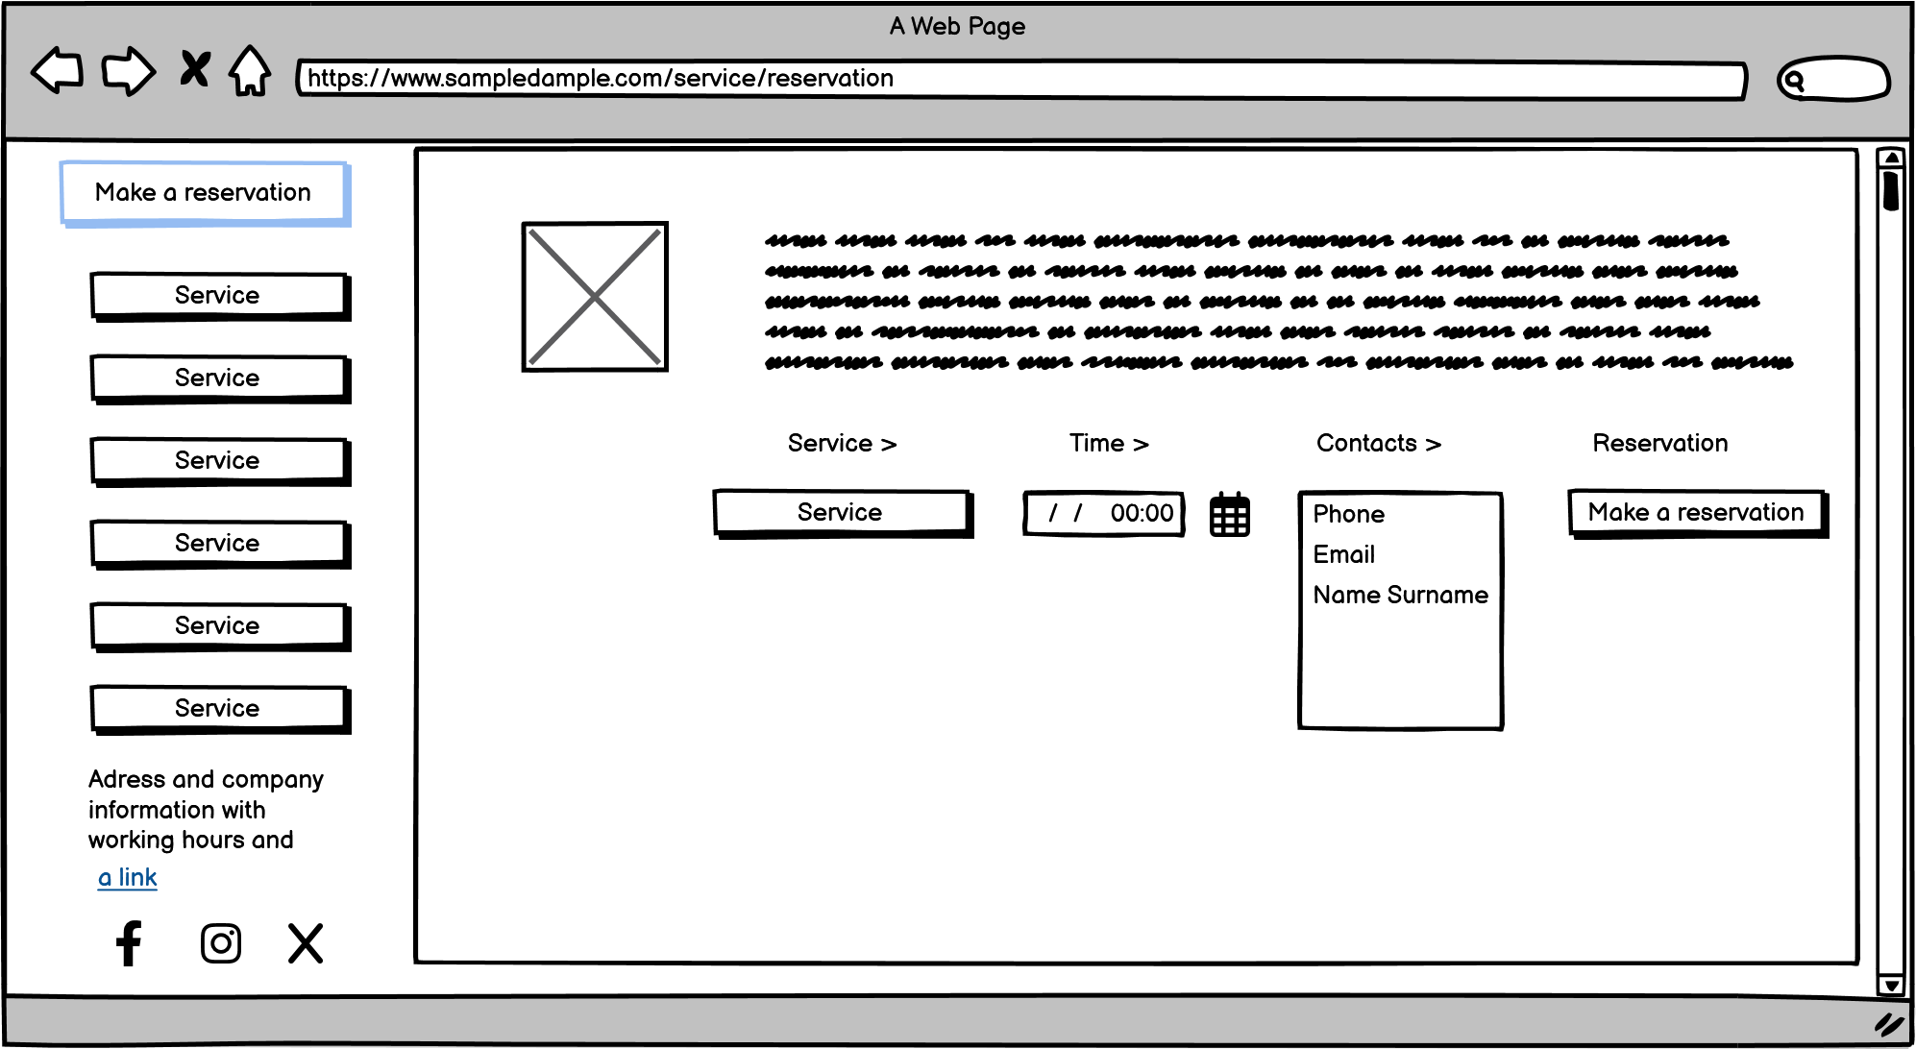
User-Friendly Design – Call To Action for booking
Notes:
User-Friendly Design: Ensure the website is easy to navigate and visually appealing
Ensure the website is easy to navigate and visually appealing

Slide 7






Site Development – used tools
For website – CMS Wordpress
Elementor for site building
Add SSL Certificate for the https
YOAST SEO add on for SEO management – sitemaps, eading management etc.
Calendly, Motopress or Salonbbokingsystem – so to manage bookings
Stripe integration for payments
Adding code snippets for calendar and stripe in page
Focus on booking system - but some in site payments may be in future
Notes:
https://www.salonbookingsystem.com/
https://motopress.com/products/appointment-booking/
https://embedcalendly.com/

Slide 8

Google – Site registration and Analytics main tasks
Register as business for Google - to find the business physical location
1
Register site for Google Search Console
2
Register/ verify for Google analytics and Ads
3
Add the Google Tags in site to track visitors
4
Also check if Facebook/ Meta Pixel also should be added – gives analytics
Analytics Integration: Implement Google Analytics to track visitor behavior and site performance
5
Collect the booking information for later use
6

Slide 9
Other slides .......Raimonds, Jurijs

Slide 10

Email Marketing
Requirements:
Emails collected from online Booking forms
Primary used for client and visitor informing and
reaching out
Managed by Mailchimp integration
Create custom Eamil campaigns – segment them
Enables A/B testing for campaigns
Mobile ready Emailing campaigns
Track open rate and etc – analyse campaigns and automate them
Let unsubscribe and etc
Notes:
https://mailchimp.com/integrations/wordpress/

Slide 11
Conclusions

